Slide 1
North Dakota Medicaid Quality
Amber Huez, MBA, RN, BSN
Medicaid Quality Manager
Medical Services Division

Slide 2
North Dakota Department of Human Services
Our mission…
to provide quality, efficient human services, which improve the lives of people.

Slide 3
North Dakota Medicaid
OUR VALUES:
We help…
our members receive safe, appropriate, quality care in a timely manner.
We communicate…
by listening, sharing information, and seeking feedback.
We partner…
with stakeholders, other state agencies, and tribes to achieve shared goals.
We oversee…
Medicaid to ensure integrity, efficiency, and stewardship of public resources.

Slide 4
In the United States…
Medicaid covers 43% of all births
4 in 10 Medicaid enrollees are Children
Medicaid covers 45% of adults with disabilities
Medicaid covers 1 in 5 Americans
Medicaid covers 6 in 10 nursing home residents
Who does Medicaid cover?
Medicaid provides health and long-term care for millions of America’s poorest and most vulnerable people.
Medicaid and Medicaid Expansion covers low-income families and nonelderly adults with income up to 138% FPL
*Data retrieved from Kaiser Family Foundation (2019) 10 Things to Know about Medicaid: Setting the Facts Straight and MACPAC (2020) Factsheet Medicaid’s Role
in Financing Maternity Care

Slide 5
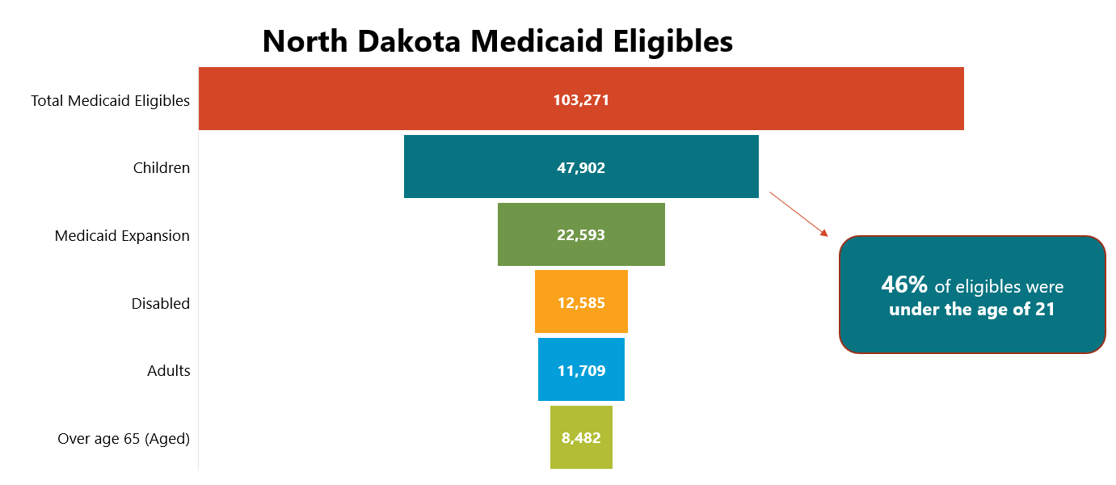

Slide 6
How Quality Improvement is defined
Robert Wood Johnson Foundation
“The process-based, data driven approach to improving the quality of care. It operates under the belief that there is always room for improving operations, processes, and activities to increase quality.”
Centers for Disease Control and Prevention
“Focuses on activities that improve population health, ensures healthcare’s affordability, and deliver the best patient experience. The framework of all Quality Improvement in healthcare ties back to: (1) Improve the health of populations, (2) Reduce the per capita cost of healthcare, and (3) Improve the patient experience.”
Institute of Medicine
“ The IOM created a framework with six domains for the health care system. This framework makes it easier for consumers to grasp the meaning and relevance of quality measures. The domains are: (1) Safe, (2) Effective, (3) Patient-centered, (4) Timely, (5) Efficient, and (6) Equitable.”

Slide 7
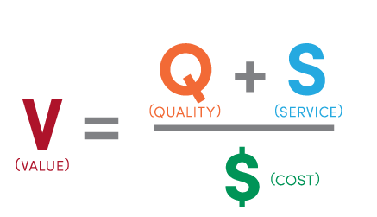
How to drive quality
Quadruple Aim for ND Medicaid
Value Equation
Better Outcomes
Smarter Spending
Healthier Populations
Better Experience
*Institute for Healthcare Improvement Triple Aim
*University of Utah & Harvard Business School’s Michael Perter value equation

Slide 8
How to improve
Continuous Quality Improvement
Is a quality management process that encourages all health care team members to continuously as the questions:
How are we doing?
Can we do it better?
The Institute for Healthcare Improvement Model for Improvement is a simple strategy that use PDSA cycle that accelerates improvement by seeking answers to three questions:
What are we trying to accomplish?
How will we know that a change is an improvement?
What changes can we make that will result in improvement?
PDSA Cycle
Plan
Do
Study
Act
*National Learning Consortium (2013) Continuous Quality Improvement Strategies to Optimize your Practice
*The W. Edwards Deming Institute PDSA Cycle

Slide 9
How quality is measured
Health Care Quality Measures for Medicaid:
Child Core Set is a set of 24 measures encompassing: preventative health, maternal health, mental health, dental health, and experience of care.
https://www.medicaid.gov/medicaid/quality-of-care/downloads/performance-measurement/2020-child-core-set.pdf
Adult Core Set is a set of 33 measures encompassing: preventative health, maternal health, mental health, dental health, and experience of care.
https://www.medicaid.gov/medicaid/quality-of-care/downloads/performance-measurement/2020-adult-core-set.pdf
ND Child Quality Measures
ND Adult Quality Measures
In 2019, ND reported on
13 Child Core Set Measures
Mandatory State Reporting for all Child Core Set Measures by 2024
In 2019, ND reported on
0 Adult Core Set Measures
Mandatory State Reporting for all Adult Behavioral Health Measures by 2024
*Retrieved from Medicaid.gov Adult and Child Health Care Quality 2020 Measures

Slide 10
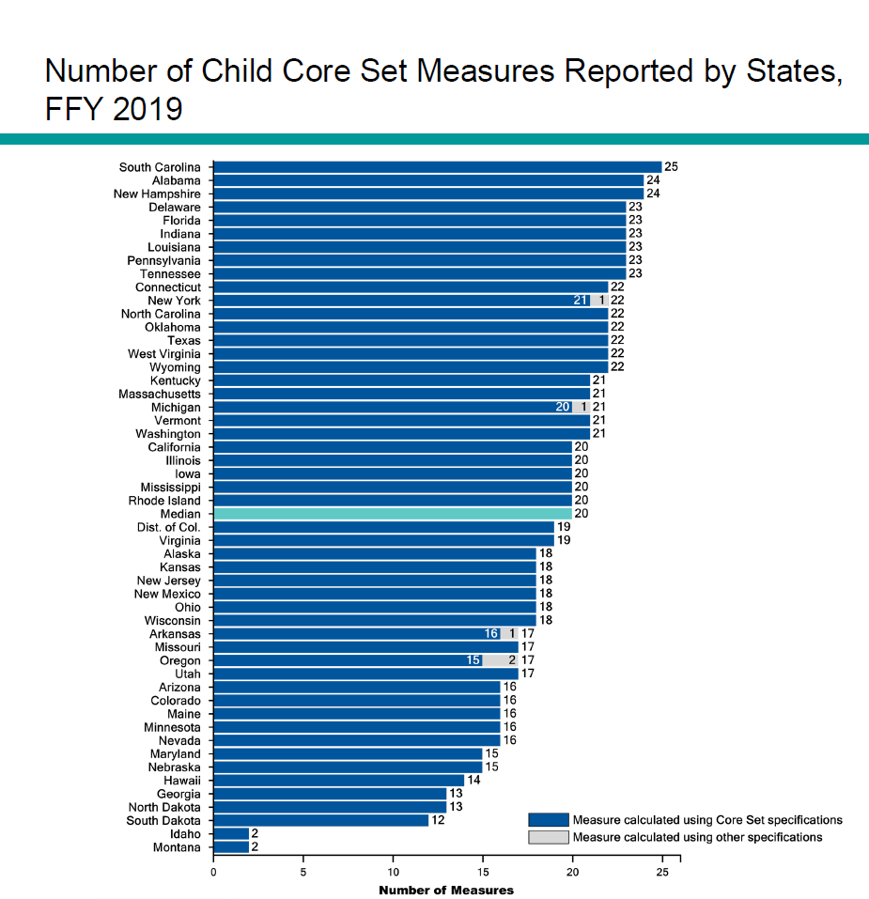
*Data retrieved from Medicaid.gov (2020) Child Chart Pack

Slide 12
Quality
is everyone’s responsibility.
~ W. Edward Deming

