Slide 1
1915(i) Billing and Claims
MMIS Web Portal Training
12/1/24

Slide 2
MMIS Web Portal
Questions and Answers
Section at the End of Presentation

Slide 3
ND Health Enterprise Web Portal 1915(i) Claim Submission
ND Health Enterprise Web Portal link: https://mmis.nd.gov/portals/wps/portal/EnterpriseHome

Slide 4
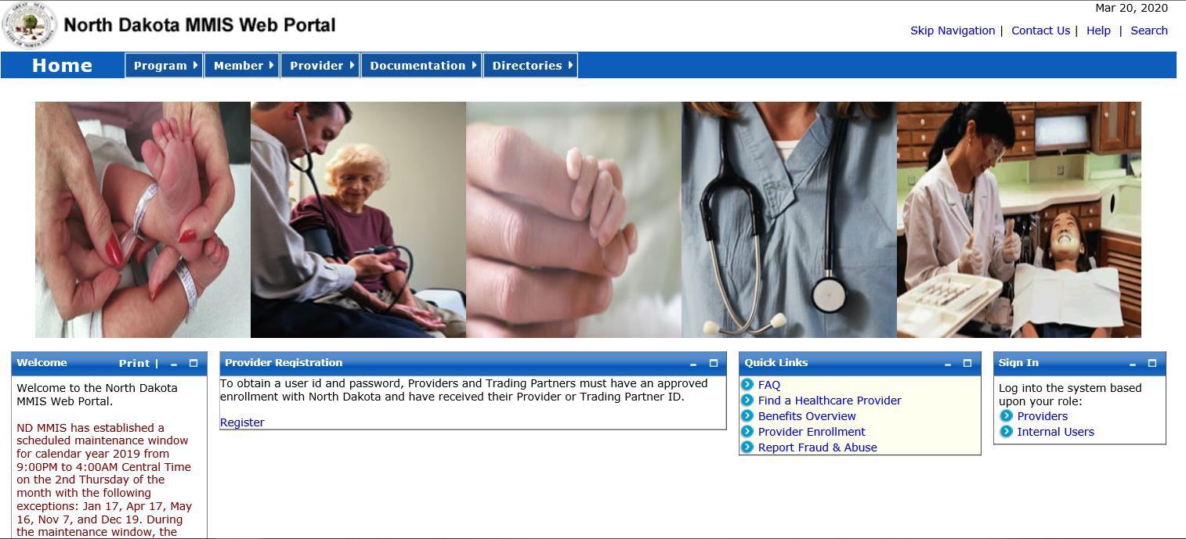
Sign In – Select Providers

Slide 5
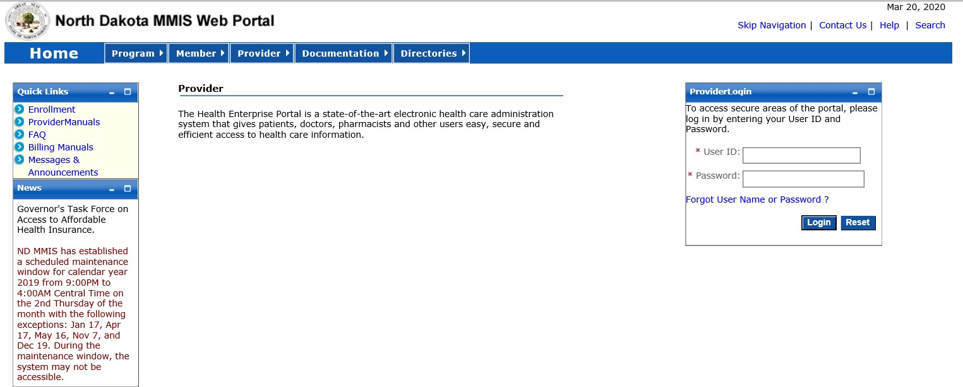
Provider Login
Enter USER ID and Password
Initial login credentials provided by Medicaid Provider Enrollment upon enrolling as a provider of 1915(i) services
Manage Provider User Security:
https://www.nd.gov/dhs/info/mmis/docs/mmis-managing-user-security-qrg.pdf

Slide 6
To Submit a Claim:
Select Claims
Create Claims
• Create Professional Claim

Slide 7
New Professional Claim
Is this a void/replacement?
Defaults to “No.”
Select “Yes” only if you are replacing or voiding a previously
processed claim.

Slide 8
New Professional Claim
Is this a void/replacement?
Select “Yes” only if you are replacing or voiding a previously processed claim.
Resubmission Type Code – Select Replacement or Void
✓ TCN to Void/Replace (TCN is Transaction Control Number)
Enter TCN (17 digit claim number) that needs to be replaced or voided

Slide 9
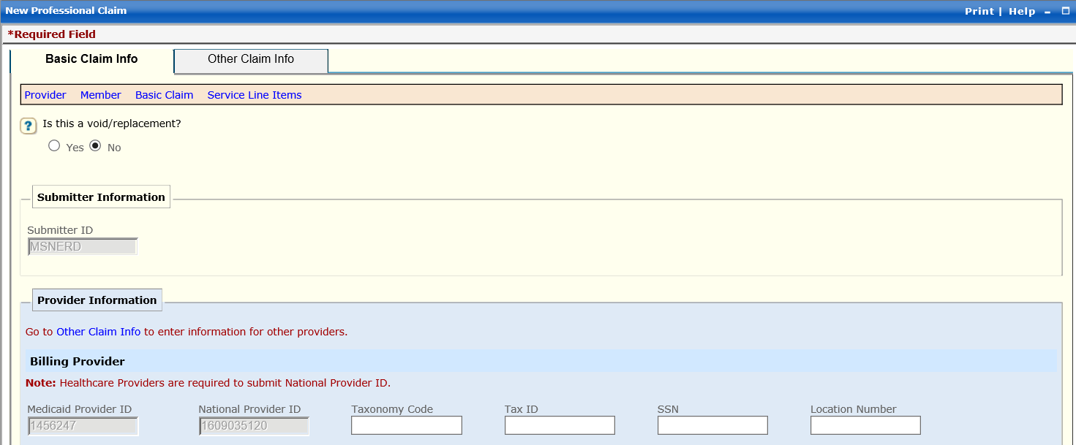
Billing Provider
Enter Taxonomy Code (provider group taxonomy code)
Enter Tax ID or SSN Number (provider group Tax ID)

Slide 10
Additional Billing Provider Information
Entity Qualifier - Select Non-Person
Enter Org/Last Name, Address, City, State and Zip
10

Slide 11
Is the Billing Provider also the Pay-To Address?
Defaults to “Yes”
If Pay-To Address is different, select “No”
Complete the Pay-To Address section with the Address, City, State, and Zip

Slide 12
Is the Billing Provider also the Rendering Provider?
If provider group name is the same as the sole employee, select “Yes”, otherwise select “No”
Enter Rendering Provider’s (individual provider performing service) Medicaid Provider ID
Must be the Rendering Provider Medicaid ID for the program being billed
Enter National Provider ID (individual provider’s 1915(i) NPI)
Enter Taxonomy Code (1915(i) taxonomy code)
Is this service the result of a referral?
Defaults to “No”
12

Slide 13
Member Information
Enter Member ID (member’s 9-digit ND Medicaid ID Number)
Must enter “ND” or “zeros” before 9-digit number
Enter Member’s Last Name
Enter Member’s First Name
Enter Member’s Date of Birth
Use format: MM/DD/YYYY
Enter Member’s Gender
F = Female
M = Male

Slide 14
Member Address
Enter Member’s Address, City, State and Zip

Slide 15
Other Insurance Information
Does the member have other insurance?
Select “No“
1915(i) services will not have any other insurance payment

Slide 16
Claim Information
Is this claim accident related?
Select “No“
Service Authorization #
Must be entered on the claim
Service Authorization Number starts with a “W” and is 10-digits
Submit only one Service Authorization Number per claim
As of 11/1/24, Service authorizations for Traditional Medicaid members are no longer required to be entered in MMIS for dates of services rendered on 11/1/24 and after. Exceptions to this are for Training & Supports and Community Transition Services which will still require SA entry to MMIS. Respite SA is entered in Therap.

Slide 17
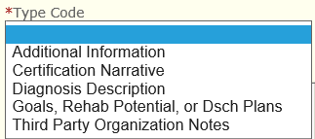
Claim Note
Not Required
Provider may add any pertinent information in this section for the department to review.

Slide 18
Claim Data
Enter Patient Account # (member’s 9-digit ND Medicaid ID Number)
Enter Place of Service (location where service was rendered)
Common Place of Service Codes
02 – Telehealth provided other than in patient’s home
10 - Telehealth provided in patient’s home
03 – School
04 – Homeless Shelter
11 – Office
12 – Home
18 – Place of Employment Worksite
CMS Approved List of Place of Service Codes
https://www.cms.gov/Medicare/Coding/place-of-service- codes/Place_of_Service_Code_Set

Slide 19
Claim Data
Assignment Code - Select “Not Assigned”
Benefits Assignment Certification - Select “Not Applicable”
Release of Information Code – Select “Yes, Provider has signed statement”

Slide 20
Diagnosis Codes
Defaults to "ICD-10"
Enter ICD-10 Code(s) that service you are billing for pertains to
ICD-10 Codes can be found on the member’s SFN 741 1915(i) Eligibility Application or Plan of Care.
If you have 3 ICD-10 codes entered in this section, then each “New Line Item” on Slide 21 has to be tied to the appropriate diagnosis code.

Slide 21
New Line Item
Enter Service Date Begin and Service Date End
Use format: MM/DD/YYYY
Must bill each day separately. (Ex. 09/01/2021 - 09/01/2021)
Dates must fall within the approved service authorization dates.
Place of Service (location where service was rendered)
Procedure Code (code that identifies the service being provided)
Modifiers (if the procedure code has a modifier, it must be entered on the claim)
Line-Item Charge Amount (dollar amount being billed)
Diagnosis Pointers – Select “First Diagnosis, Second Diagnosis, etc.” to tie to appropriate ICD-10 code(s) entered on Slide 20
Unit Code – Select “Units”
Units (how many units are being billed)
To bill for multiple days, select “Save” after completing the fields above, then select “Add Service Line Item”. Repeat “New Line Item” entry as above.

Slide 22
As of 11/1/24, Service authorizations for Traditional Medicaid members are no longer required to be entered in MMIS for dates of services rendered on 11/1/24 and after. Exceptions to this are for Training & Supports and Community Transition Services which will still require SA entry to MMIS. Respite SA is entered in Therap.
Service Authorization
Service Authorization #
Must be entered on the claim
Service Authorization Number starts with a “W” and is 10-digits
Submit only one Service Authorization Number per claim

Slide 23
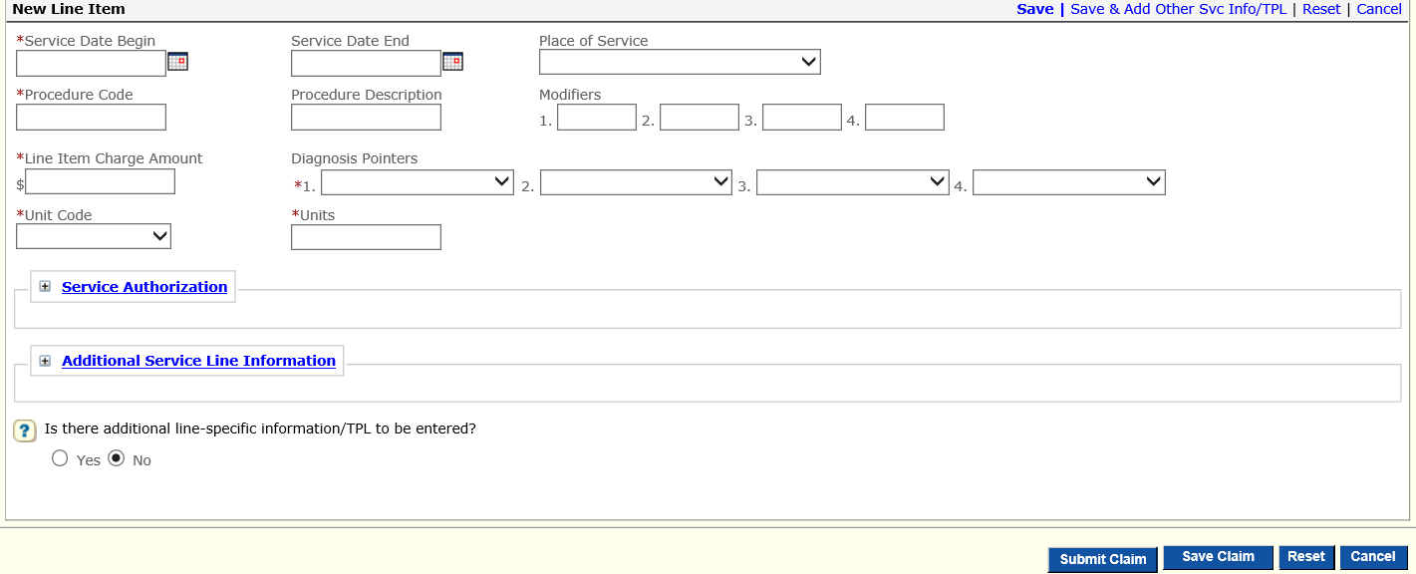
Is there additional line-specific information/TPL to be entered?
Select “No“
1915(i) services will not have any other insurance payment
Select “Save"
Select “Save Claim”
Select “Submit Claim”

Slide 24
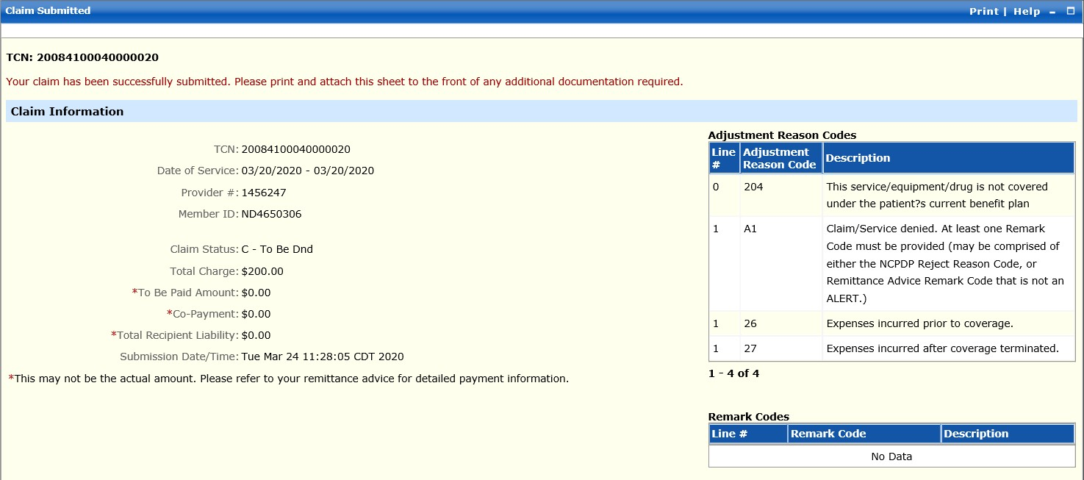
Print and Save for your records

Slide 25
MMIS Web Portal
Questions and Answers

Slide 26
Q. Do the Place of Service (POS) on Claim Data (Slide 18) and the New Line Item (Slide 21) Place of Service (POS) need to match?
A. No. Different Place of Service’s (POS) can be billed on the same claim on separate "New Line Items”. Provider would select the appropriate POS on the "New Line Item" where the service was rendered.
Claim Data section only allows the provider to select one POS.
Each day of service must be billed separately on a New Line Item. See Slide 21 to bill for multiple days of service.

Slide 27
Q. What is the difference between Non-Person Entity or Person Entity in the Entity Qualifier (Slide 10)?
A. 1915(i) providers will select Non-Person which is the agency (group provider).
1915(i) requires individual providers be affiliated with an agency (group provider).

Slide 28
Q. Who is the Rendering Provider (Slide 12)?
A. The individual provider performing the service for the member.

Slide 29
Q. Do I have to select Diagnosis Pointers on each "New Line Item"?
A. Yes. If there are multiple diagnosis codes pertaining to the service performed, select first, second, ect. to correspond with ICD-10 code(s) entered in Slide 20.

Slide 30
Q. Do I need to enter the Service Authorization Number on the claim?
A. Yes. Enter the Service Authorization Number in the Claim Information (Slide 16) and New Line Item (Slide 22).
As of 11/1/24, Service authorizations for Traditional Medicaid members are no longer required to be entered in MMIS for dates of services rendered on 11/1/24 and after. Exceptions to this are for Training & Supports and Community Transition Services which will still require SA entry to MMIS. Respite SA is entered in Therap.
30

